Slide 1

Introduction to Spring Framework

Slide 2
Outlines :-
1. Overview of Spring
2. Spring Framework Modules
3. Inversion of control
4. Dependency Injection
5. Bean life Cycle
6. Scope of Bean
7. Concept of AutoWiring.

Slide 3
What is Spring Framework ?
Spring is the most popular application development framework for enterprise java.
Open Source java platform since 2003.
Spring support all major application servers and JEE Standards.
Spring handlers the infrastructure so you can focus on application.

Slide 4
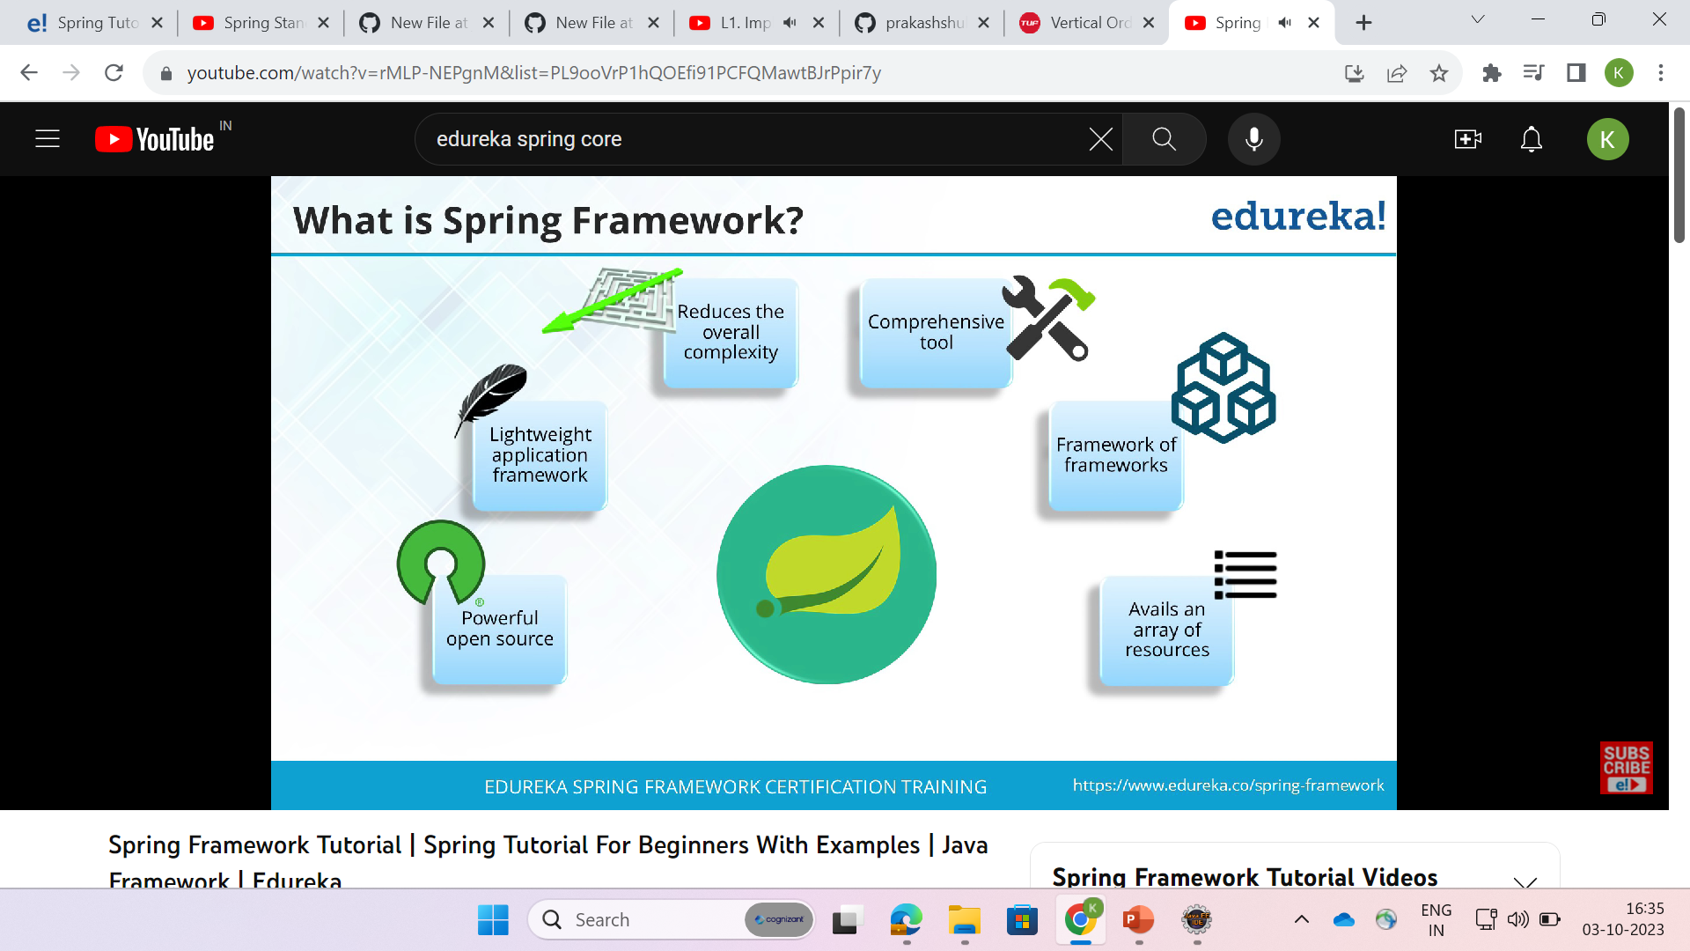
Features of Spring Framework

Slide 5
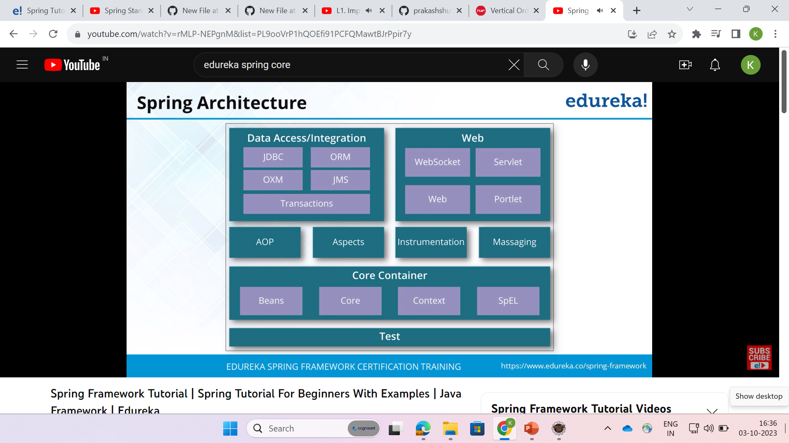
Spring Architecture

Slide 6
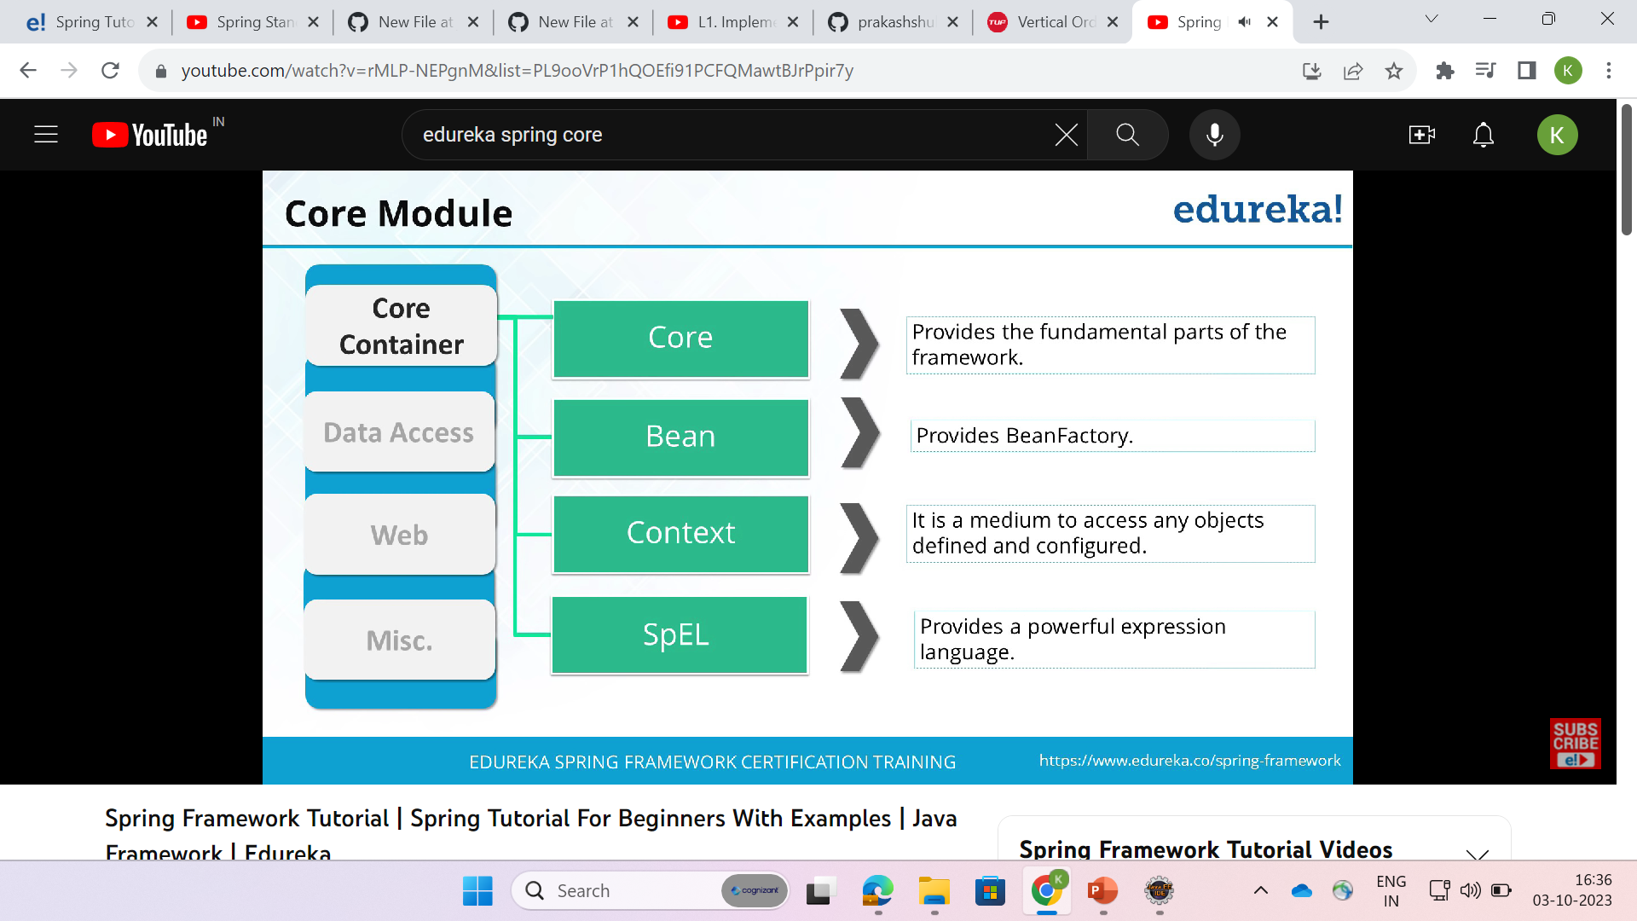
Core Modules

Slide 7
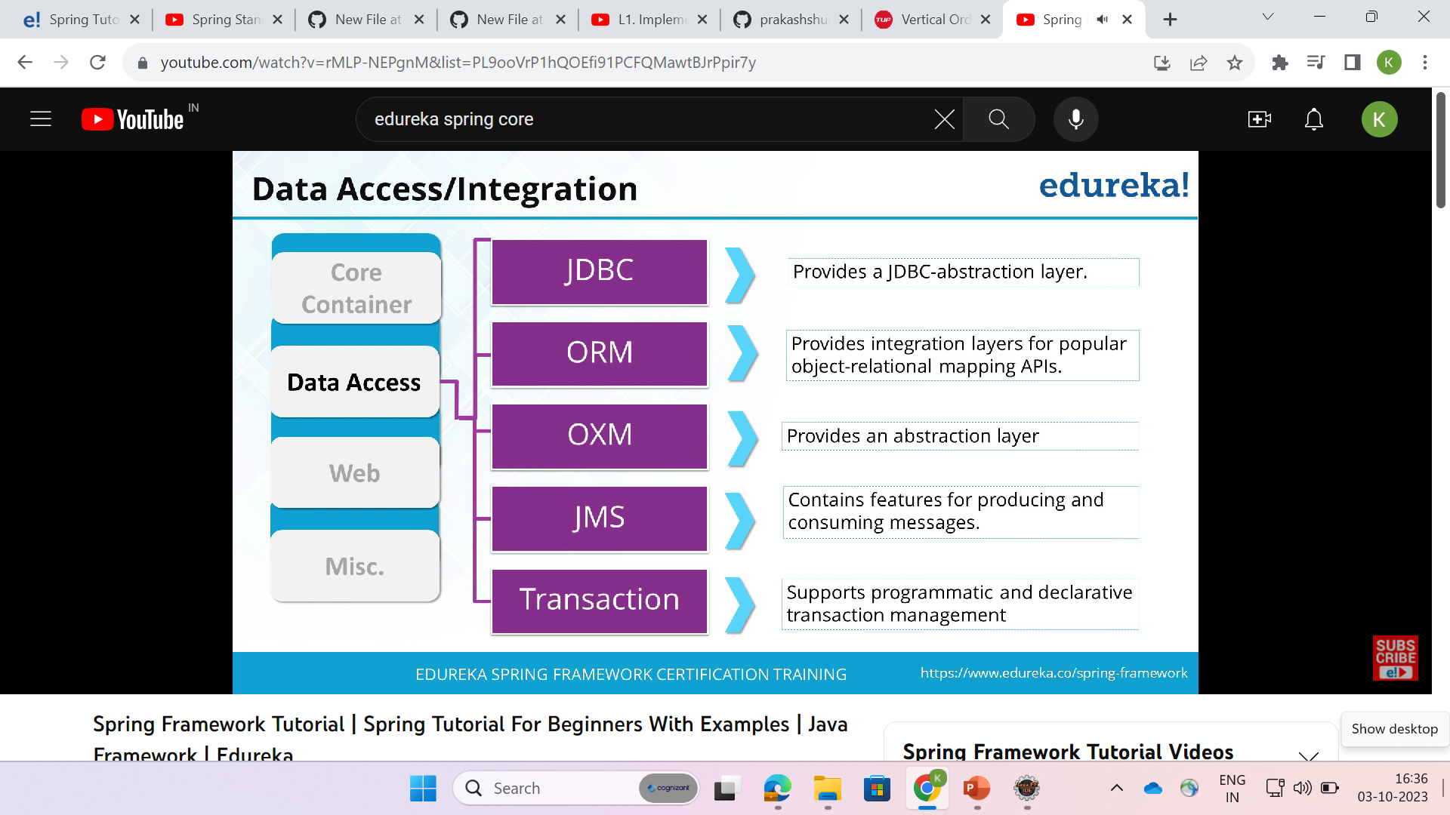
Data access/Integration

Slide 8
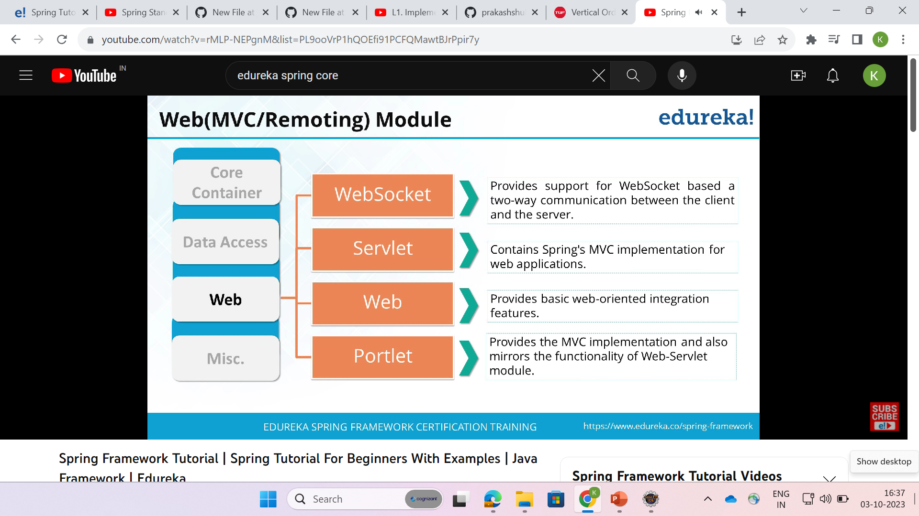
Web(MVC/Remoting) Module :-

Slide 9
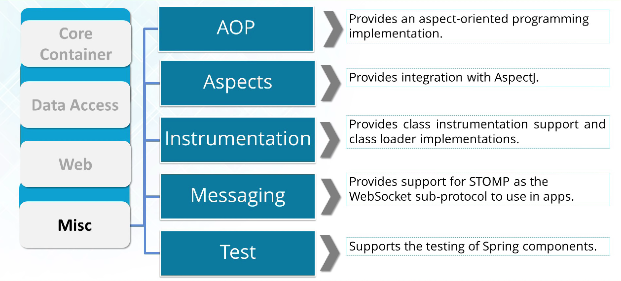
Miscellaneous

Slide 10
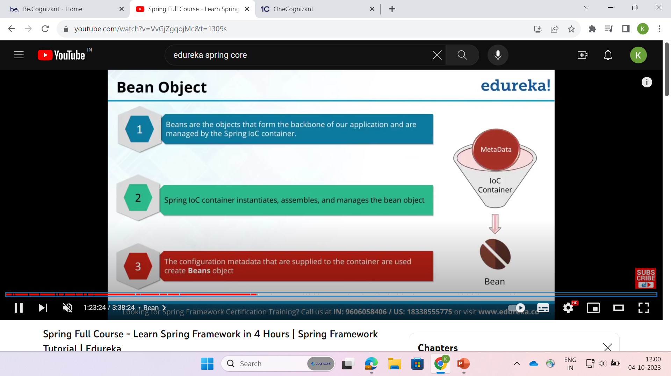
Spring Bean

Slide 11
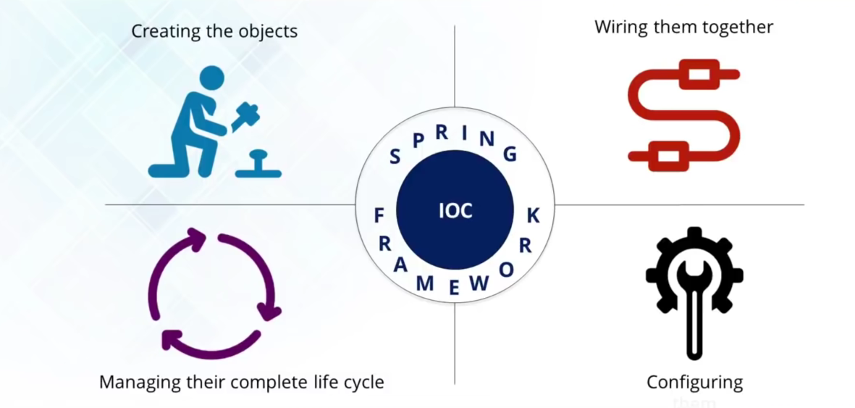
IOC Container

Slide 12
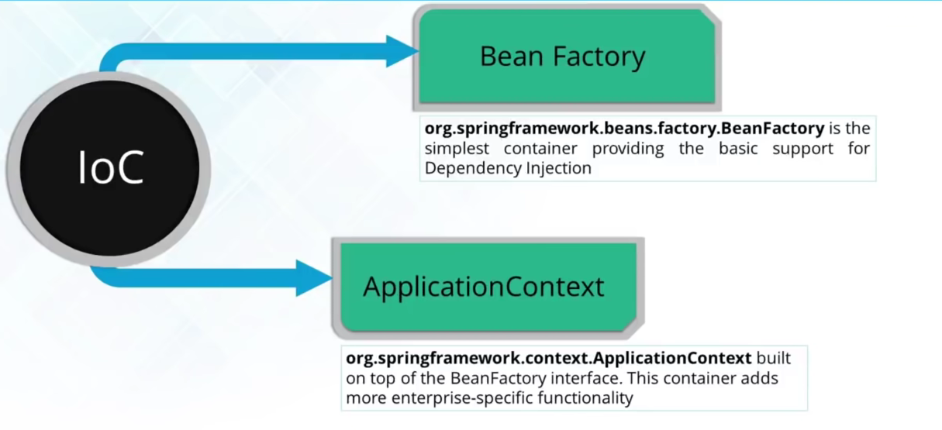
Types of IOC Container

Slide 13
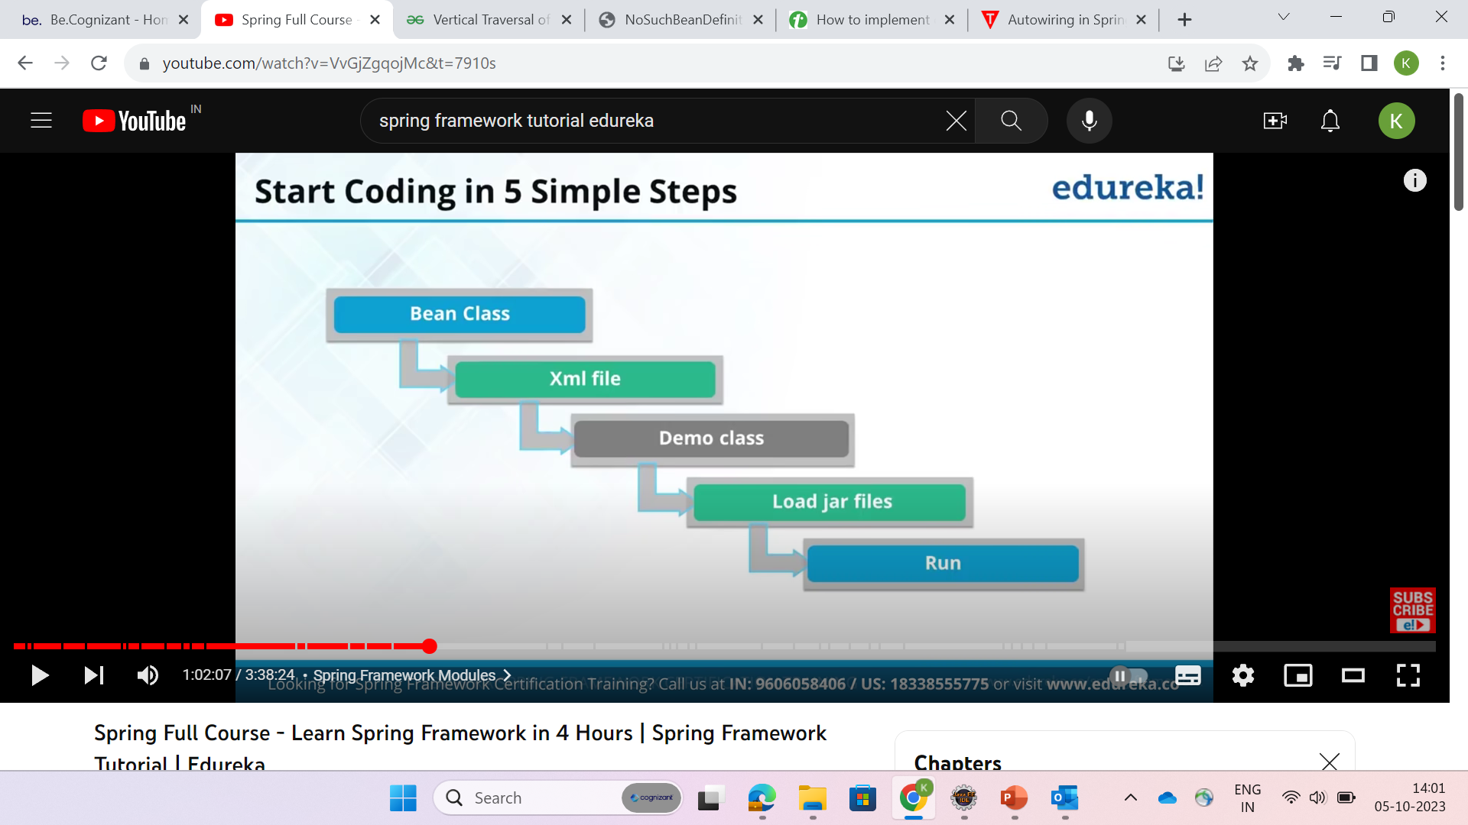
Structure of Code :-

Slide 14
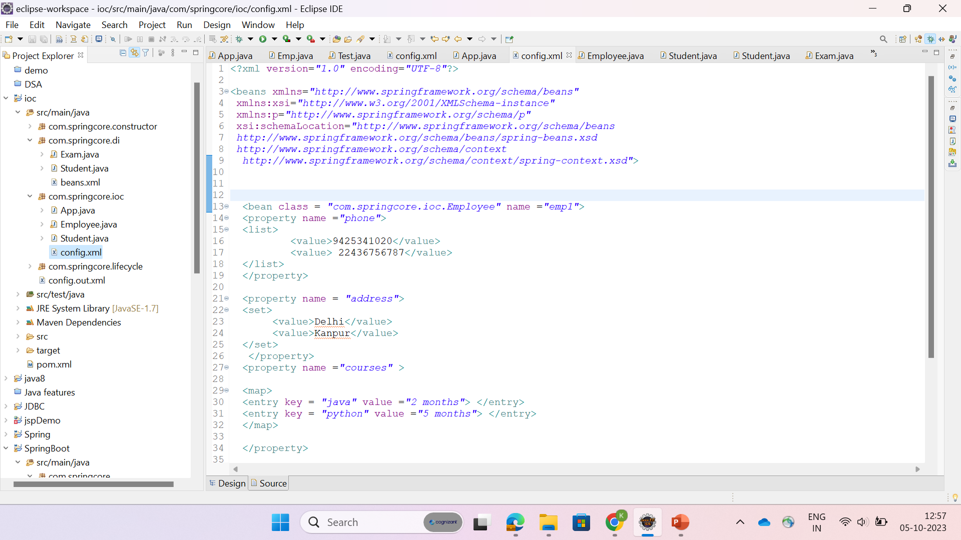

Slide 15
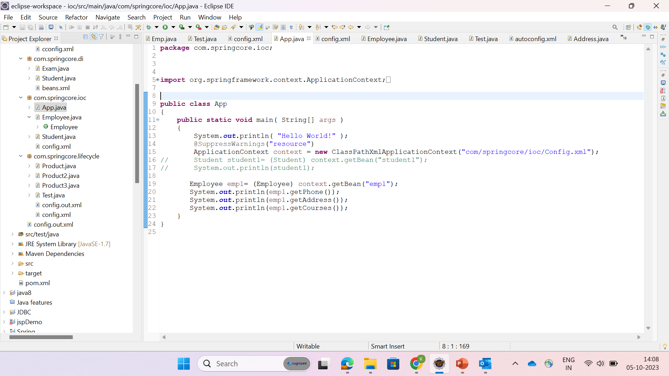

Slide 16
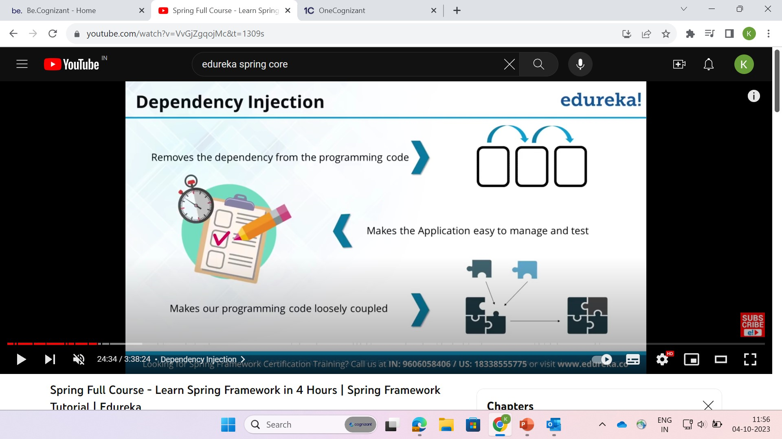
Dependency Injection

Slide 17
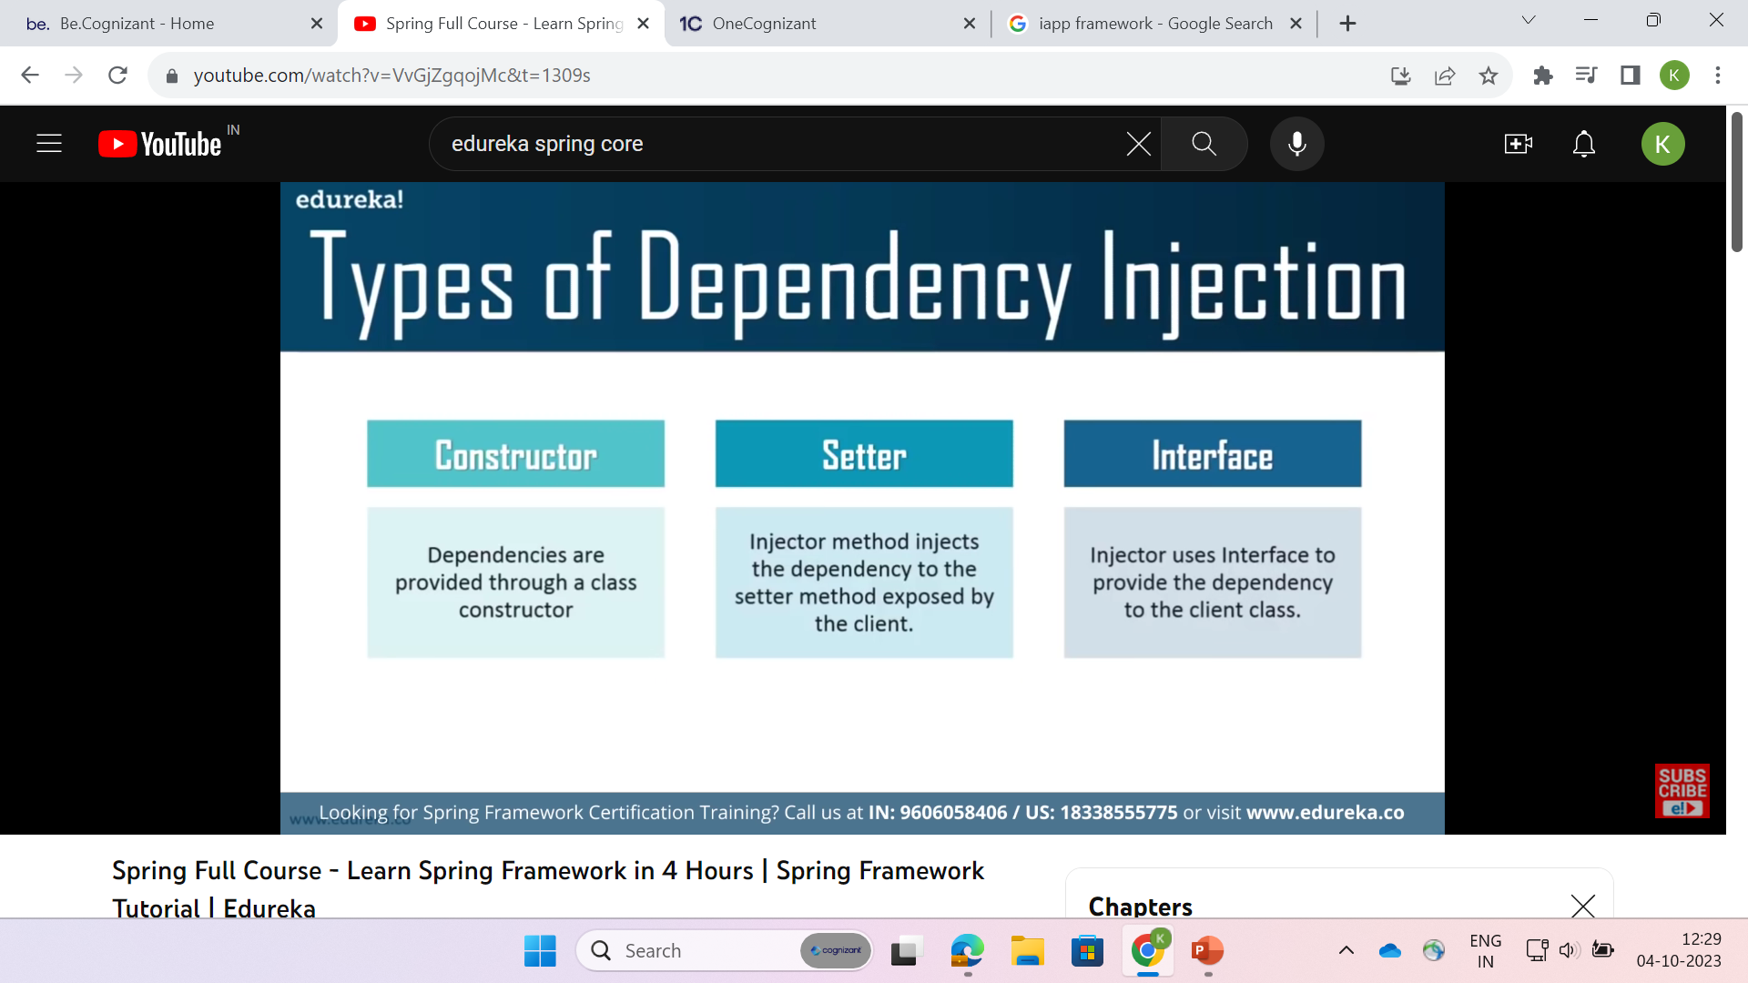

Slide 18
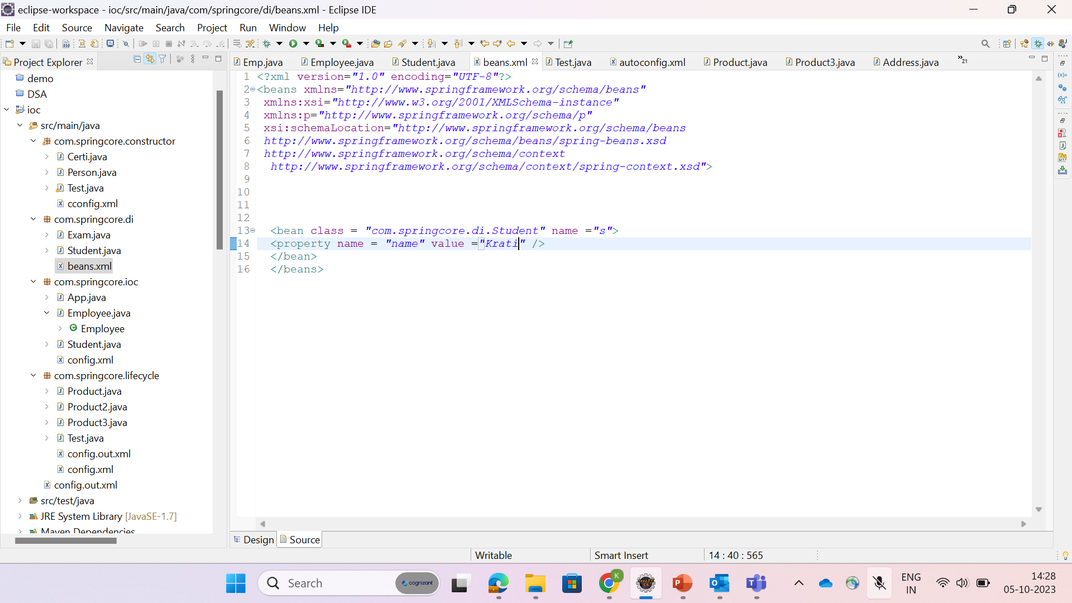

Slide 19
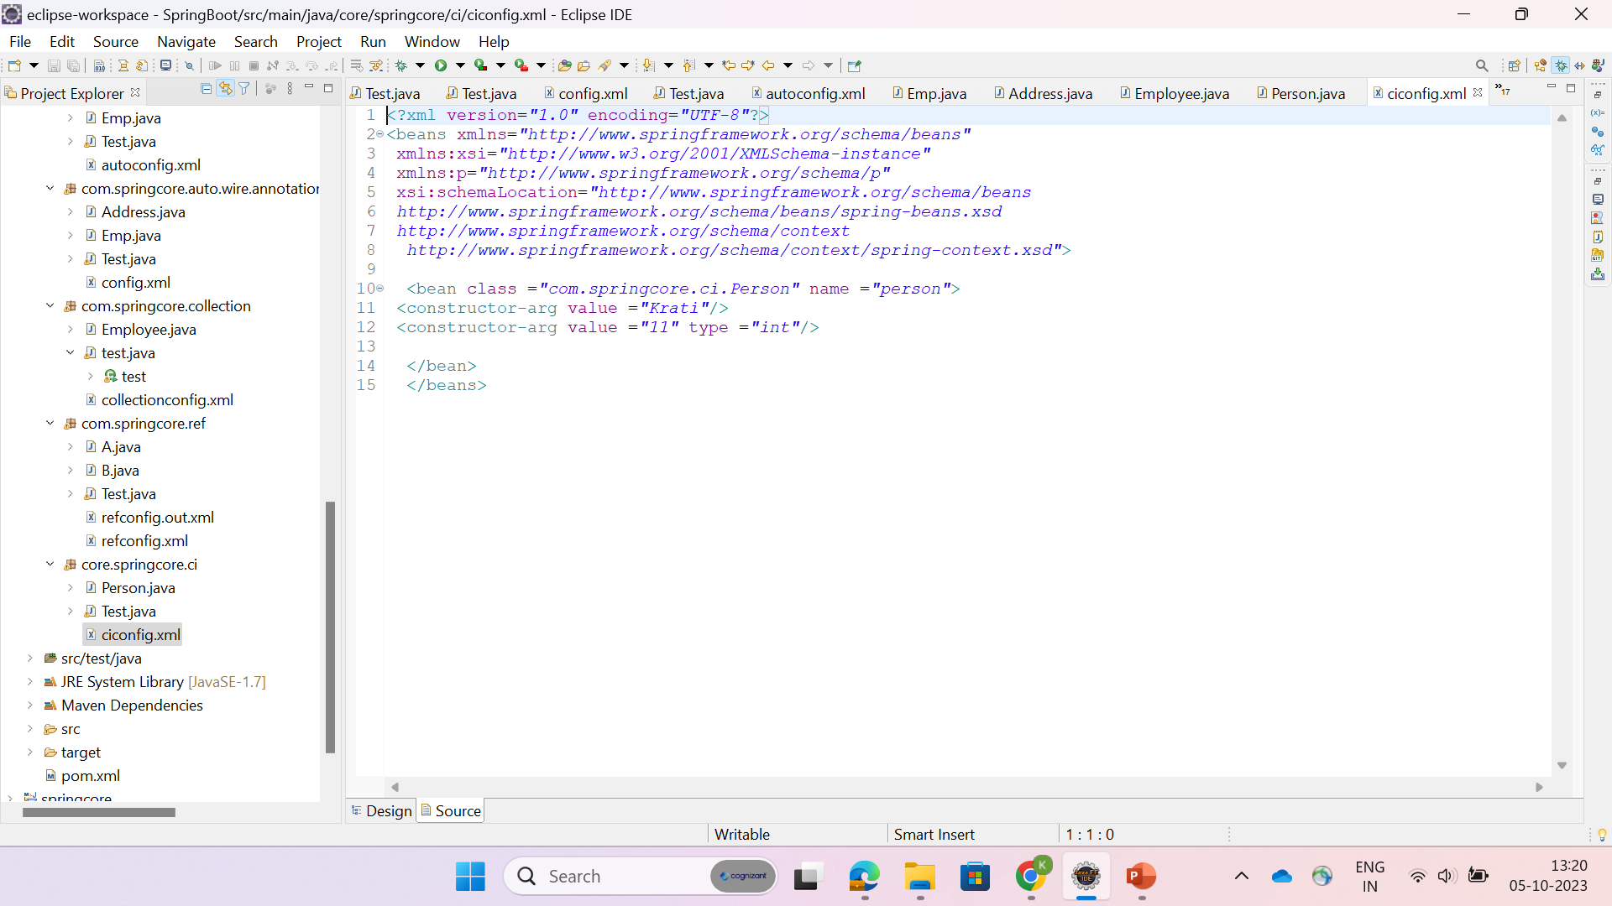

Slide 20
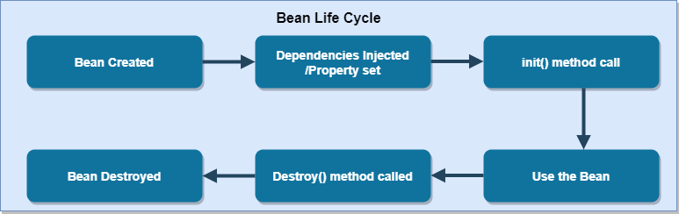
Spring Bean Life Cycle :-

Slide 21
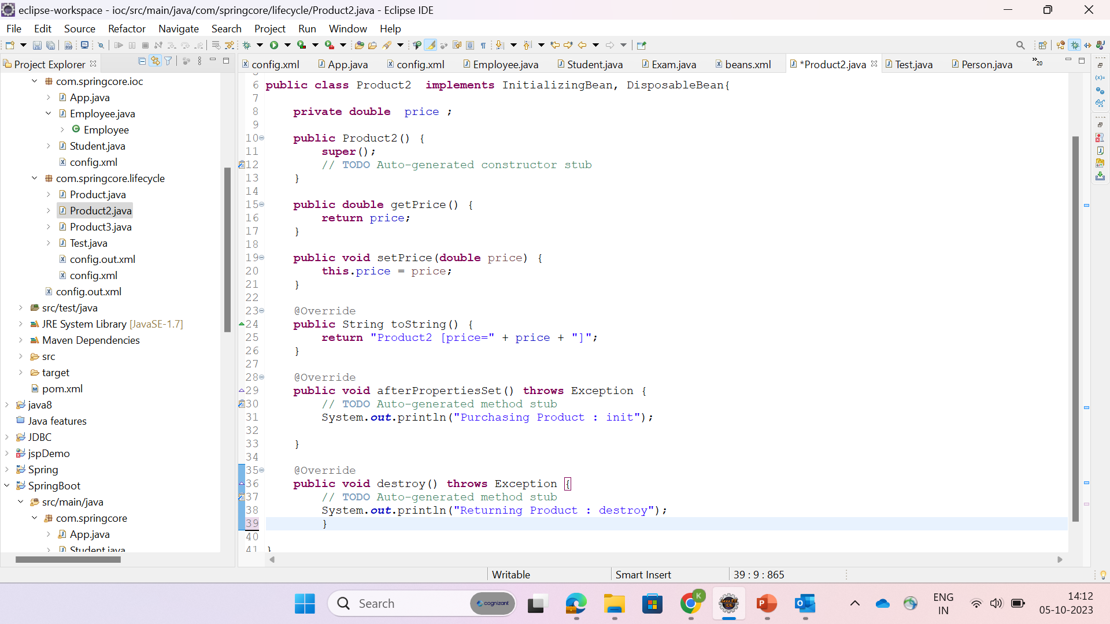

Slide 22
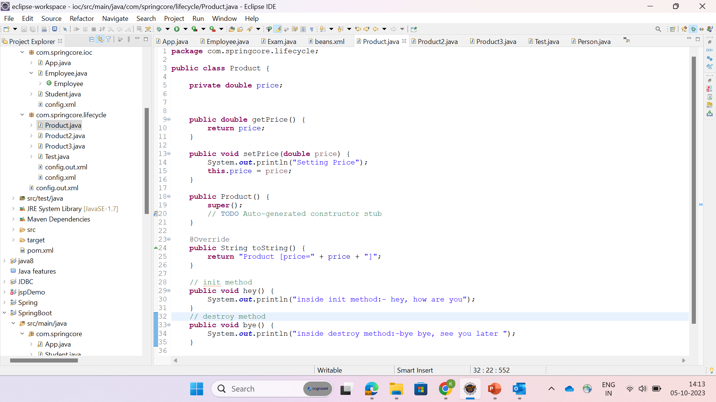

Slide 23
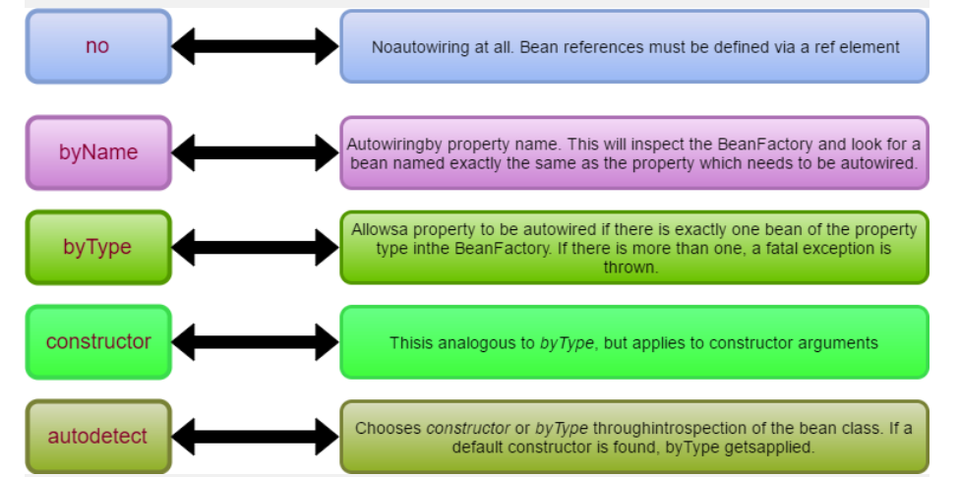
Spring AutoWiring Modes

Slide 24
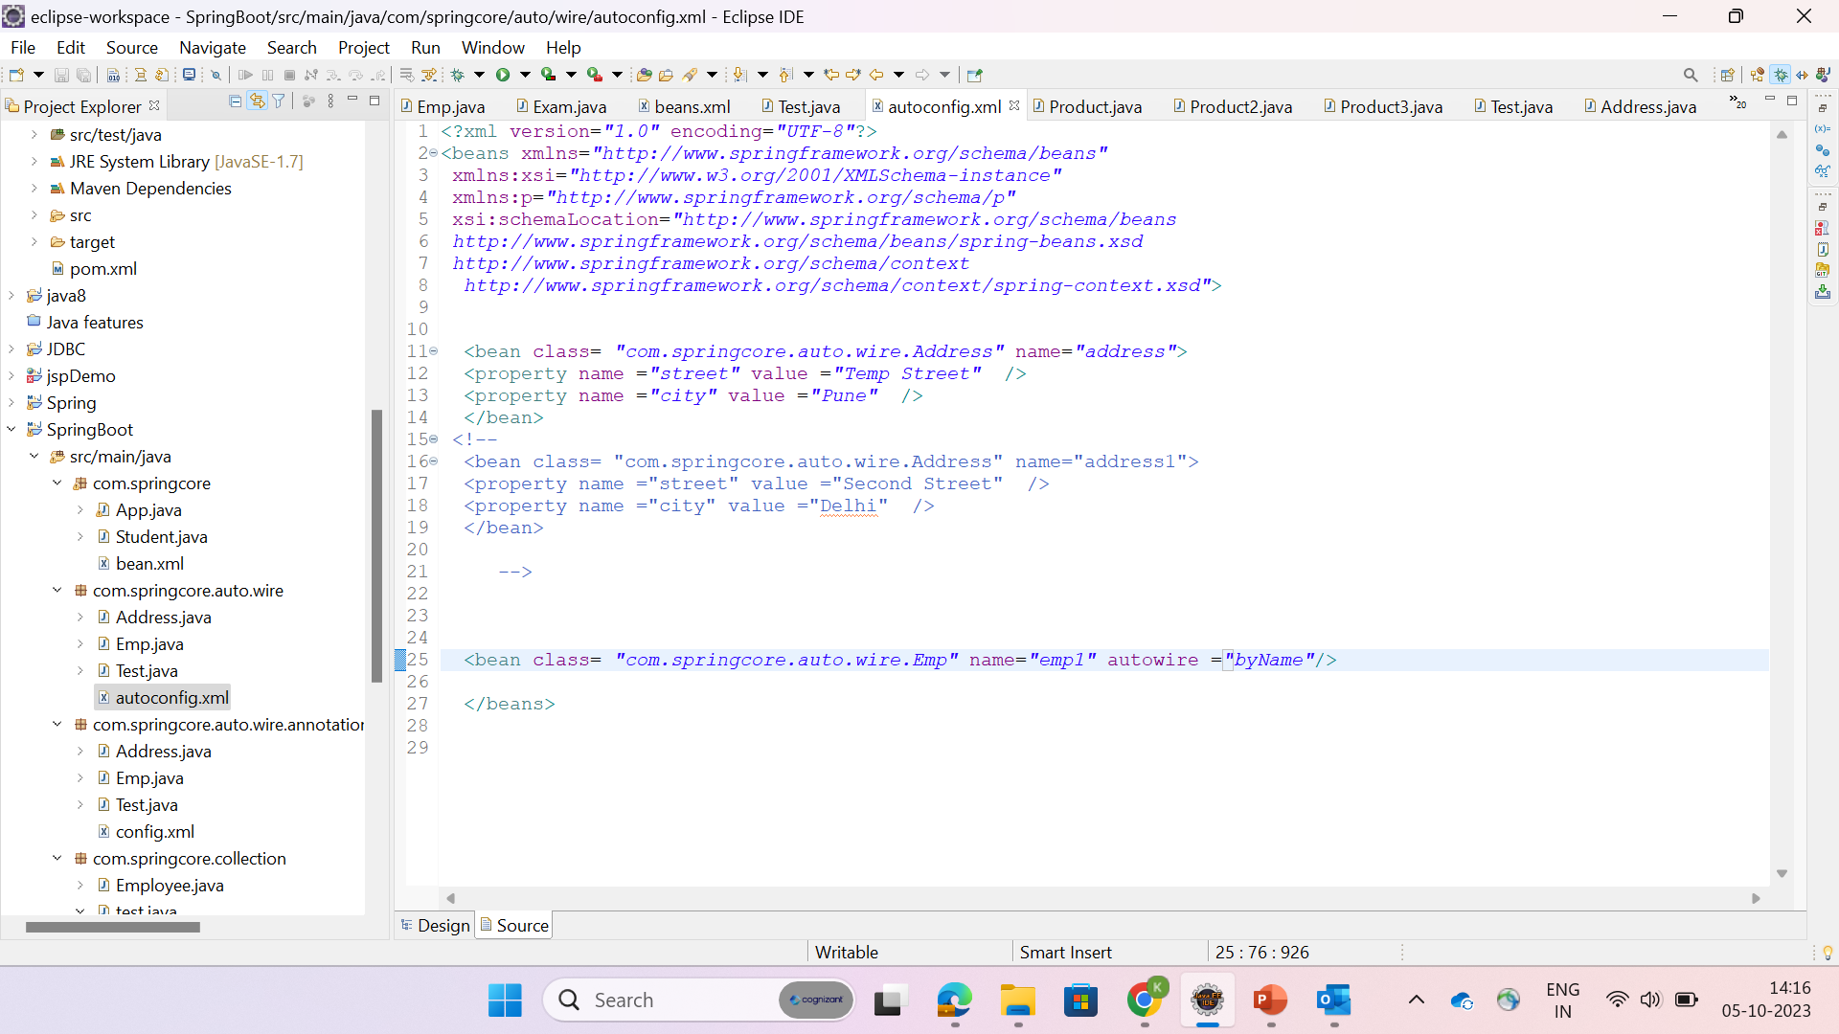

Slide 25
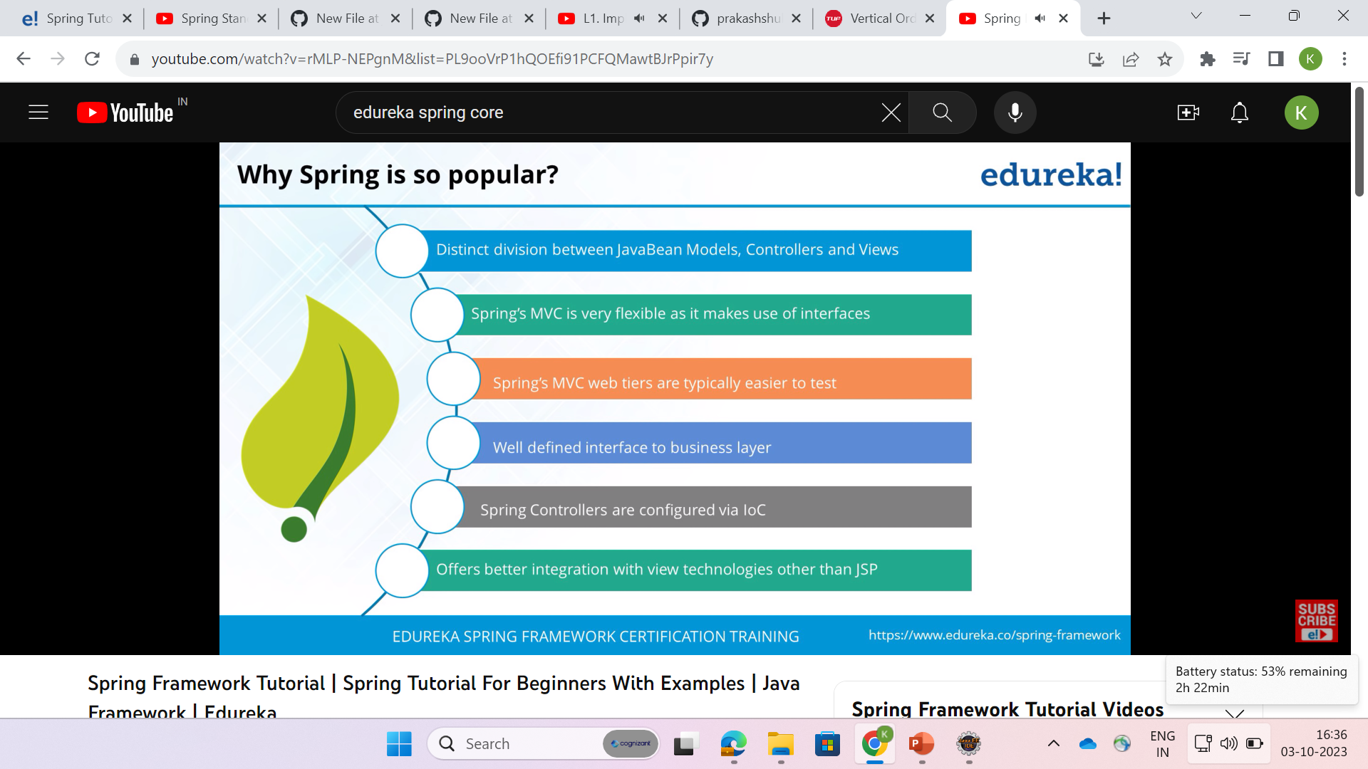
Summary

Slide 26
Thank You !!

